Slide 1
MTH1203: Probability and Statistics
Lecture 06 (BSCS, BSDS, BSIT)
Topic: Combining Probability and Statistics for continuous variables
Dr. Daphne Nyachaki Bitalo
Department of Computing & Technology
Faculty of Engineering, Design & Technology
Fri 6th Sept 2024

Slide 2
Lecture Objectives
The Objective of this lecture is to:
Combine the concepts of probability and statistics to answer key questions
Use a real-world health dataset to get insights (Dataset on breast cancer provided on Moodle)

Slide 3
Visualising distribution of a variable
Histogram for a continuous variable
How many times each value appears in dataset. This description is called the distribution of variable
Most common way to represent distribution of continuous variable is histogram that is graph which shows frequency of each value.
Frequency = number of times each value appears
Example: [1,1,1,1,2,2,2]. Frequency of 1 is four and frequency of 2 is three.

Slide 4
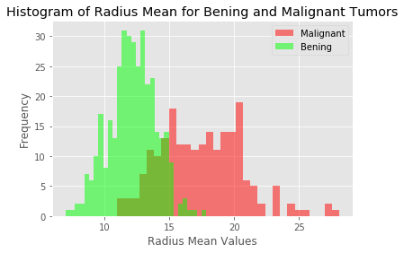
Distribution of a variable
Histogram of breast cancer data
From this graph you can see that radius mean of malignant tumors are bigger than radius mean of benign tumors mostly.
The bening distribution (green in graph) is bell-shaped that is shape of normal distribution (gaussian distribution)

Slide 5
Testing for normal distribution
So the distribution of data has to be testing using the following:
1. Visual inspection [normal plots (histogram), Q-Q plot (quantile-quantile plot)], boxplots)
2. Significance tests. Such as Shapiro-Wilk’s test (samples >3< 5000) and Kolmogorov-Smirnov (K-S) test (samples > 5000)
Data distribution also informs how missing data is handled

Slide 6
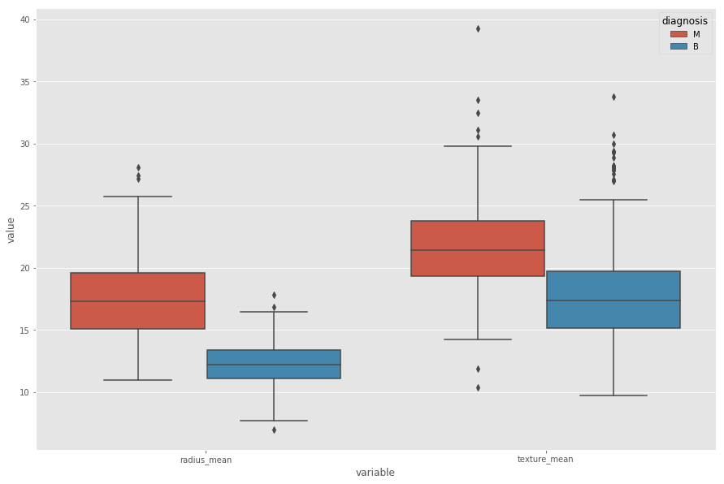
Outliers in a variable
Checking for outliers using a boxplot

Slide 7
Outliers in a variable
Checking for outliers using statistics
While looking histogram and boxplot, we can see there are rare values in bening distribution There values can be errors or rare events.
These errors and rare events can be called outliers.
Calculating outliers:
first we need to calculate first quartile (Q1)(25%)
then find IQR (interquartile range) = Q3-Q1
finally compute Q1 - 1.5IQR and Q3 + 1.5IQR
Anything outside this range is an outlier

Slide 8
Descriptive statistics of a variable
Statistics for central tendency and distribution of a variable
Mean
Median
Variance: spread of distribution
Standard deviation square root of variance
Let's look at summary statistics of benign tumor radiance mean

Slide 9
Descriptive statistics of variables
Effect size as a key descriptive statistic when comparing two groups
It describes size of an effect. It is simple way of quantifying the difference between two groups.
In an other saying, effect size emphasises the size of the difference
Use cohen effect size
Cohen suggest that if d(effect size)= 0.2, it is small effect size, d = 0.5 medium effect size, d = 0.8 large effect size.
Compare size of the effect between benign radius mean and malignant radius mean

Slide 10
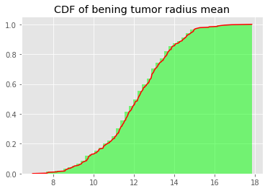
Probability distribution-CDF
Statistics for central tendency and distribution of a variable
Cumulative distribution function is the probability that the continuous variable takes a value less than or equal to x. P(X <= x)
For instance, what is the probability of a benign tumour radius mean being less than 12. P(12 < X)?
The answer is 0.5. The probability that the variable takes a values less than or equal to 12(radius mean) is 0.5.

Slide 11
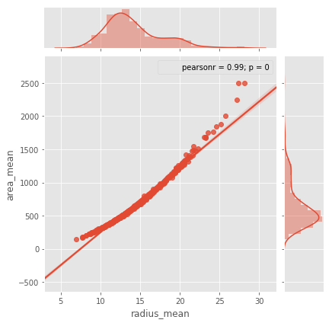
Relationship between variables
Scatterplot to visualise relationship between continuous variables
Let’s look at relationship between radius mean and area mean in our cancer dataset
In scatter plot you can see that when radius mean increases, area mean also increases. Therefore, they are positively correlated with each other.

Slide 12
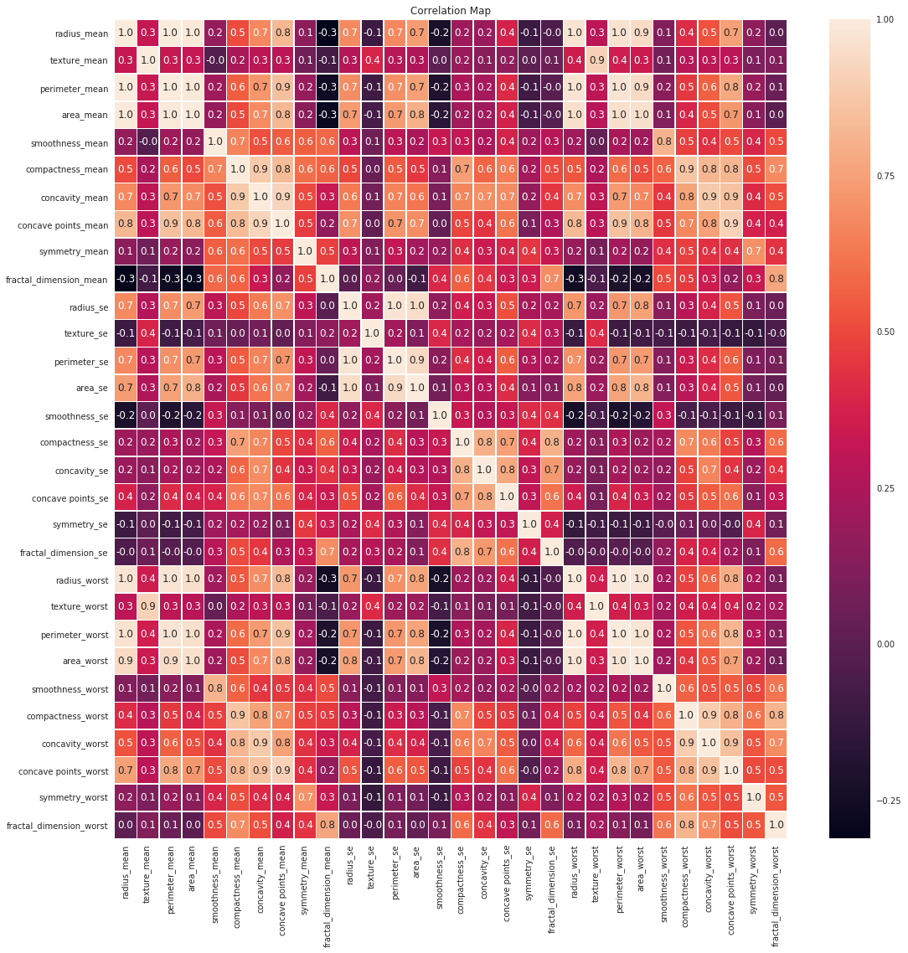
Relationship between variables
Statistically using correlation
Strength of the relationship between continuous variables
Ranges from -1 to 1.
Meaning of 1 is variables are positively correlated with each other
Meaning of zero is no correlation between variables
Meaning of -1 is two variables are negatively correlated

Slide 13
Types of correlation
Pearson’s correlation
Pearson correlation works well if the relationship between variables are linear and variables are roughly normal.
But it is not robust, if there are outliers
Spearman's Rank correlation
If relationship between distributions are non-linear, spearman's correlation tends to better estimate the strength of relationship
Spearman's correlation is more robust to outliers.

Slide 14
Variability between variables
Covariance
Covariance is measure of the tendency of two continuous variables to vary together (change)
So covariance is maximized if two vectors are identical
Covariance is zero if they are orthogonal.
Covariance is negative if they point in opposite direction (inversely related)
Let’s look at covariance between radius mean and area mean. Then look at radius mean and fractal dimension se

